Slide 1
Making maps and analyzing spatial data An introduction to using R for archaeologists
Liying Wang
Workshop, June 2020

Slide 2
Workshop content
Archaeologists deal with spatial data very often and R is a useful tool to manipulate, visualize, and analyze spatial data
We make our work transparent and reproducible with R code
Three topics are covered
Making maps
spatial data manipulation and visualization
Density analysis and hypothesis testing to test our theory about distributions.

Slide 3
Workshop structure
I will
introduce the packages we use and types of spatial data
explain the functions and the result
demonstrate the code in R Markdown file
You will
practice running code (## Exercise) in R Markdown file
let me know if you encounter any issues

Slide 4



R Packages we will use for today
rnaturalearth, rnaturalearthdata: spatial data download
sf, sp, raster: spatial classes
tidyverse, maptools: data manipulation, and spatial objects manipulation
ggplot2, ggmap, ggspatial: visualizations
spatstat: spatial data analysis
Shadowtext: text for ggplot2

Slide 5

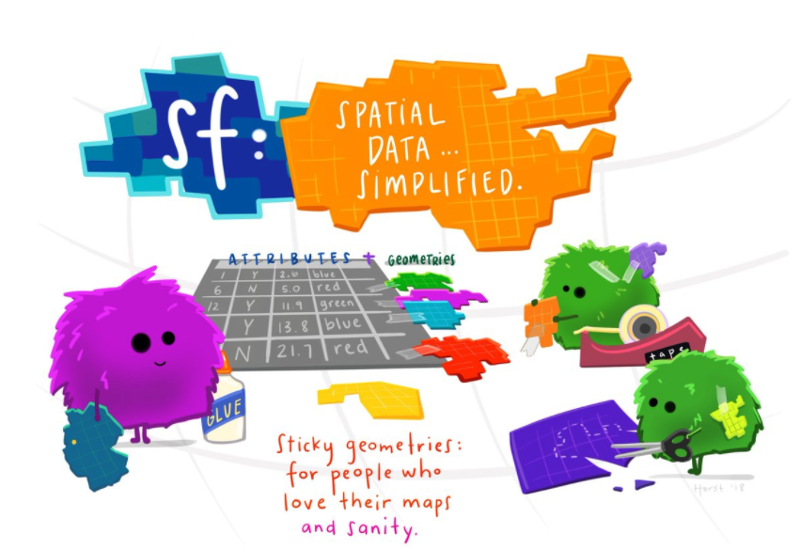
simple features: attributes and geometries in the form of a data frame
The Illustation is made by Allison Horst
Artist-in-Residence at RStudio

Slide 6
Set up: install packages and download data

Slide 7
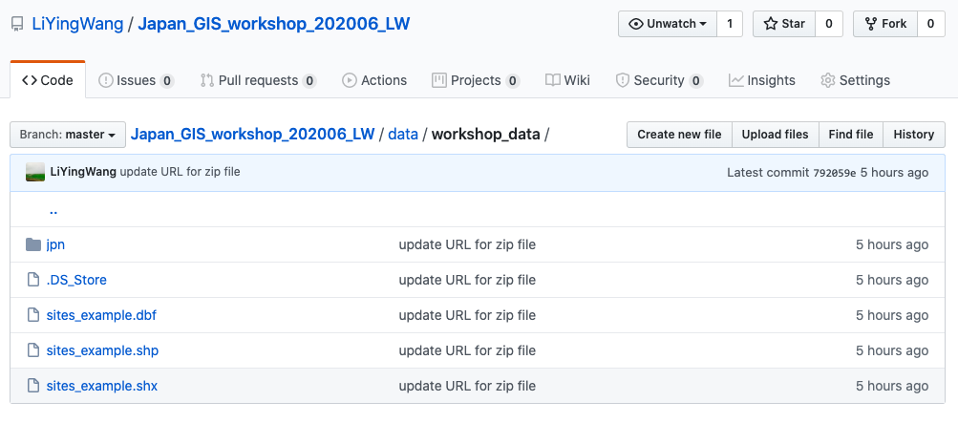

The raster data is from https://www.gsi.go.jp/kankyochiri/gm_japan_e.html

Slide 8

Let’s work on it together
install.packages()
download.file()

Slide 9
Part 1: Making maps

Slide 10
Making maps
Regional maps: small-scale maps show larger area with a smaller amount of detail, eg. World map
Site maps: large-scale maps show smaller area with a greater amount of detail

Slide 11
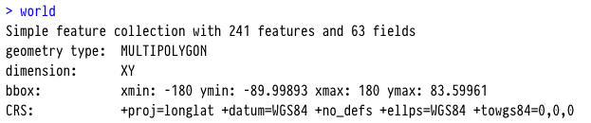
Regional map
library(rnaturalearth)
library(rnaturalearthdata)
world <- ne_countries(scale = "medium", returnclass = "sf") # pulls country data

Slide 12
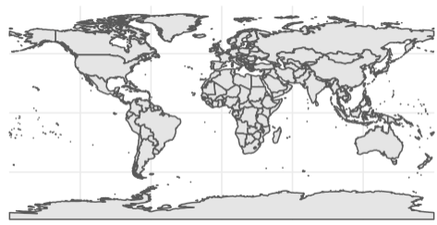
library(ggplot2)
ggplot(data = world) +
geom_sf() +
theme_minimal()

Slide 13
Your turn ## Exercise 1

Slide 14
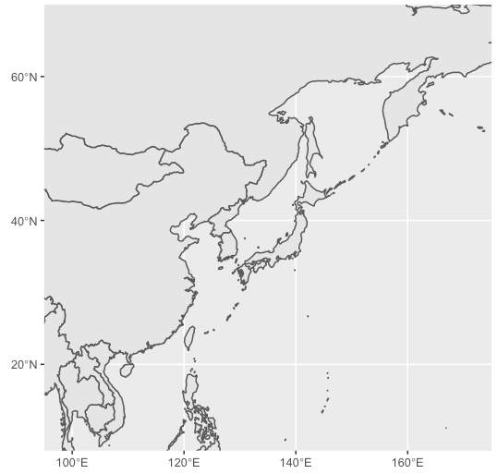
JP_NE_Asia <-
ggplot(data = world) +
geom_sf() +
coord_sf(xlim = c(95, 175
ylim = c(8, 70),
expand = FALSE) +
scale_x_continuous(breaks = seq(100, 160, by = 20)) +
scale_y_continuous(breaks = seq(20, 65, by = 20)) +
theme(
axis.title.x = element_blank(),
axis.title.y = element_blank())

Slide 15
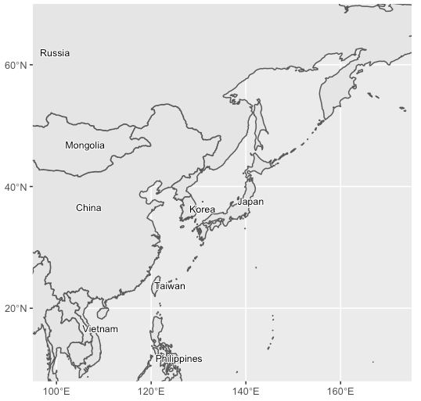
What if we want to label the countries on the map?

Slide 16
Your turn ## Exercise 2

Slide 17
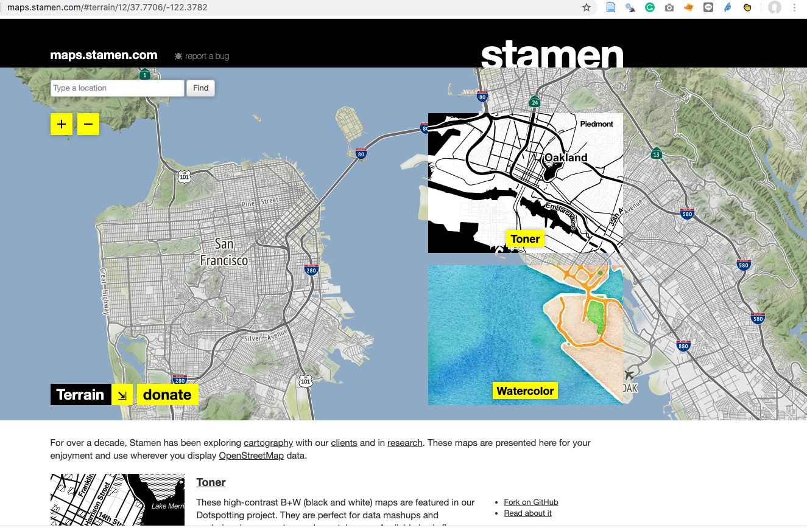
Site map
Use get_stamenmap () function to get terrain map
http://maps.stamen.com/#terrain/12/37.7706/-122.3782

Slide 18
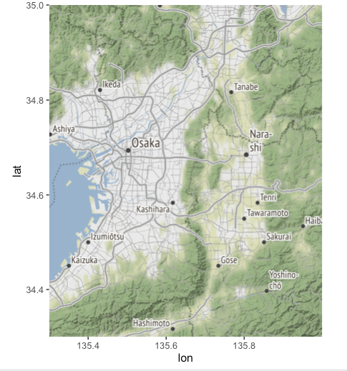
ggmap is a package to visualize spatial data
ggmap(get_stamenmap(rbind(as.numeric(c(135.3, 34.3, 136.0, 35))), zoom = 10))

Slide 19
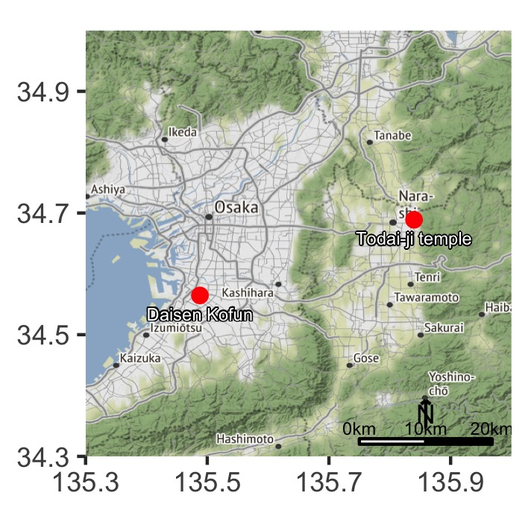
To make a site map, we will need to add the locations of site on it

Slide 20
Your turn ## Exercise 3

Slide 21
We have learned:
Read data for mapping into R
Making regional map
Making site map

Slide 22
Part 2: Spatial data manipulation and visualization

Slide 23
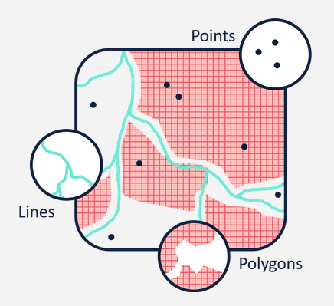
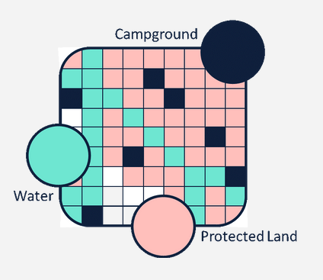
Vector stores geospatial data as points, lines, and polygons
Raster stores geospatial data as a surface divided into a series of cells (pixels)
https://www.vebuso.com/2019/01/vector-raster-tale-two-spatial-data-types/

Slide 24
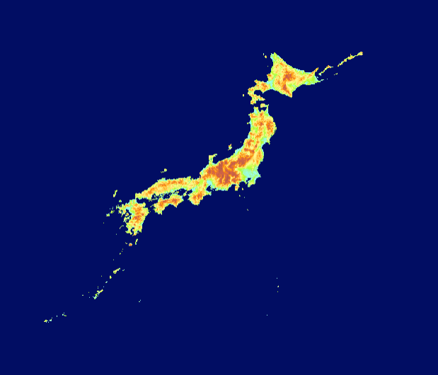
library(raster) DEM_Japan <- raster("data/workshop_data/jpn/el.tif") plot(DEM_Japan)
Digital elevation model (DEM) download from Global Map Japan

Slide 25
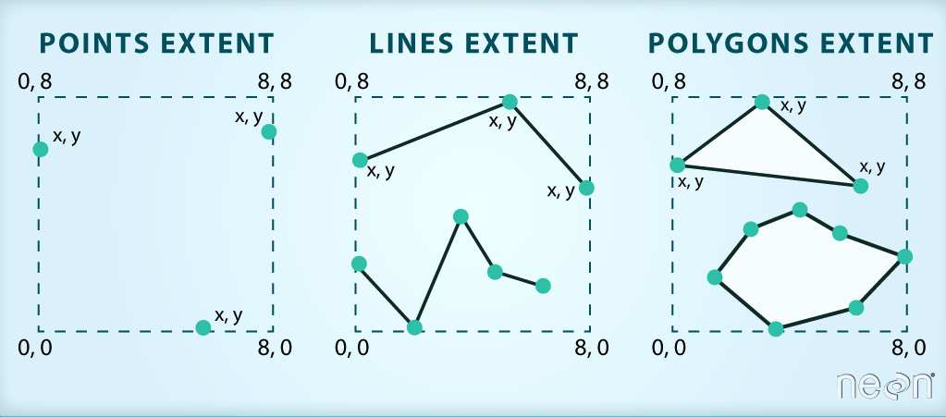
Crop a raster to match our site map
Clip a raster using a Shapefile
https://datacarpentry.org/r-raster-vector-geospatial/11-vector-raster-integration/index.html

Slide 26
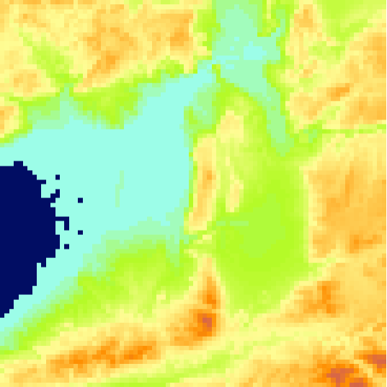
x_coord <- c(135.3, 135.3, 136, 136, 135.3)
y_coord <- c(34.3, 35, 35, 34.3, 34.3)
xym <- cbind(x_coord, y_coord)
library(sp)
p = Polygon(xym)
ps = Polygons(list(p),1)
sps = SpatialPolygons(list(ps))
crs(sps) <- crs(DEM_Japan)
crop_DEM <- crop(DEM_Japan, sps)
spatial object
summary(crop_DEM)

Slide 27
Your turn ## Exercise 4

Slide 28
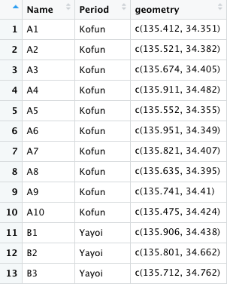
shapefile: site locations
sites_location <- st_read("data/workshop_data/sites_example.shp")

Slide 29
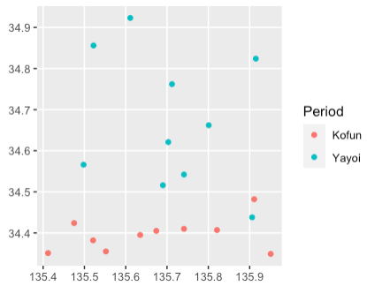
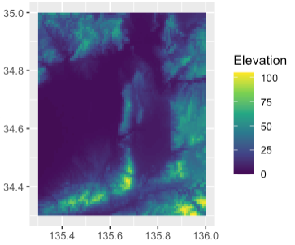
Add the sites onto the cropped raster data
+

Slide 30
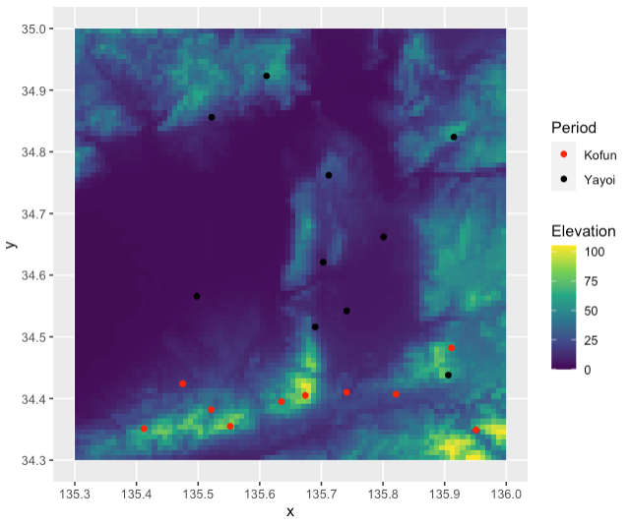
ggplot() +
geom_raster(data = crop_DEM_df, aes(x = x, y = y, fill = el)) +
geom_sf(data = sites_location, aes(color = Period)) +
scale_color_manual(values=c("red", "black")) +
scale_fill_viridis_c(name = "Elevation") +
coord_sf()

Slide 31
Your turn ## Exercise 5

Slide 32
Get the elevation for the sites from raster data
extract(crop_DEM,
sp_sites_location,
method = "simple")
The simple method here is to use values for the cell a point falls in

Slide 33
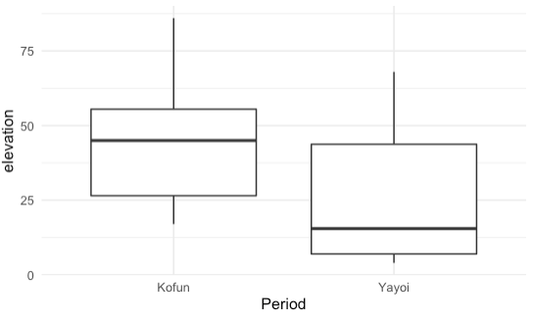
sites_location %>% ggplot(aes(Period, elevation)) + geom_boxplot() + theme_minimal()

Slide 34
Your turn ## Exercise 6

Slide 35
We have learned:
Read raster data, and crop the area we want
Add sites onto the raster map using ggplot
Extract elevation from raster data for site locations

Slide 36
Part 3: Density analysis and hypothesis testing

Slide 37
Visualization of density
spatstat package
density function which computes an isotropic kernel intensity estimate of the point pattern.

Slide 38
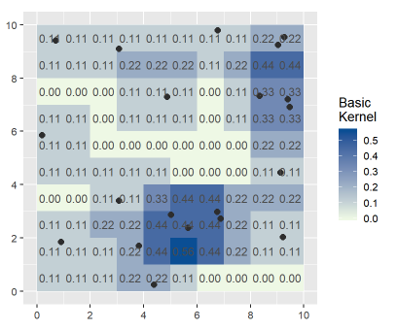
If there is one point in a 3x3 unit (pixel) region, then the density value is 1/9 = 0.11

Slide 39
Your turn ## Exercise 7

Slide 40
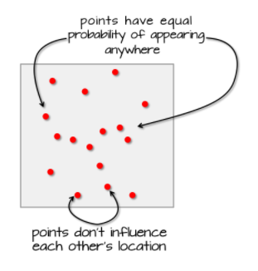
Spatial data analysis
how to determine the distribution of sites or artifacts is random or not?
presence, absence, and null (missing)
complete spatial randomnesss (CSR)
https://mgimond.github.io/Spatial/hypothesis-testing.html

Slide 41
We can test for CSR by comparing the observed value with a distribution of points under the process which was completely random
The Average Nearest Neighbor method- measures the distance between each feature centroid and its nearest neighbor's centroid location.

Slide 42
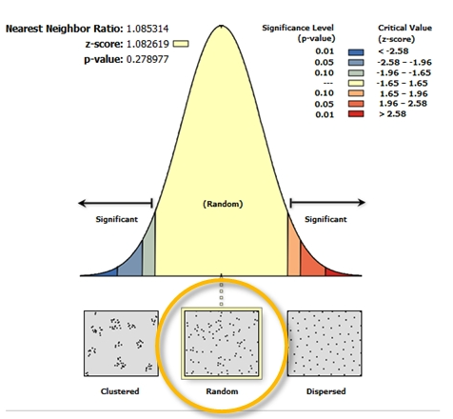

Slide 43
Your turn ## Exercise 8

Slide 44
We have learned:
Density visualization
Hypothesis testing for distribution

Slide 45
Contact me
Email: liying15@uw.edu
Twitter: @LiyingWang10

Slide 46


